Slide 1


Fraud Detection in UPI Transactions
Team Name: Zero_One
Team Members:-
Prakhar Srivastava(Leader)
Kumar Aditya
Hiramani Chauhan
Ranjeet Kumar

Slide 2
NPCI
Problem Statement
Financial institutions face challenges in detecting and preventing fraudulent transactions, which can result in significant financial losses.
Develop an AI/ML model that analyzes transaction patterns and user behaviors to detect and flag potentially fraudulent activities on UPI scale.
Evidence
The Reserve Bank of India (RBI) reported a 35% rise in digital payment frauds in FY 2023.According to NPCI, UPI fraud cases have increased with growing adoption, surpassing 10 billion transactions per month in India.
Adaptivity & Dynamicity: Development of learning mechanisms which can update the model in response to new fraudulent transactions
Real Time scalability: The model should be scalable for a large amount of data for real time applications.

Slide 3
Dataset
Dataset Used: UPI transaction data.
Key Fraud Indicators:
- Unusual transaction patterns
- Mismatched sender-receiver details
- High-risk scores
- Device, location, and IP anomalies

Slide 4
Technology Used
Machine Learning Model: XGBoost
Frameworks: FastAPI
Libraries: Pandas, NumPy, Scikit-Learn
Deployment: Model served via API.
Code Implementation
Backend: FastAPI-based service.
Preprocessing: Feature engineering.
Model Training: XGBoost with tuning.
API: Fraud probability prediction.

Slide 5
Challenges-Solutions
Challenges Faced:
- Data cleaning & missing values
- Identifying key fraud features
- Model deployment & API integration
Solutions Implemented:
- Used frequency encoding
- Fine-tuned model
- Designed scalable API

Slide 6
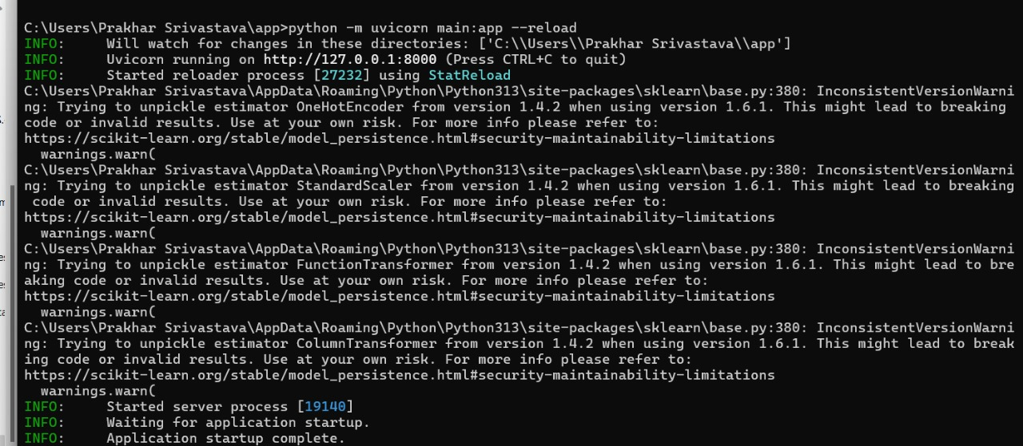
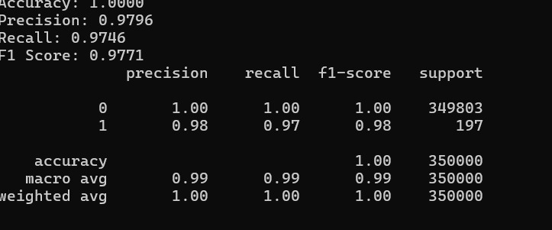
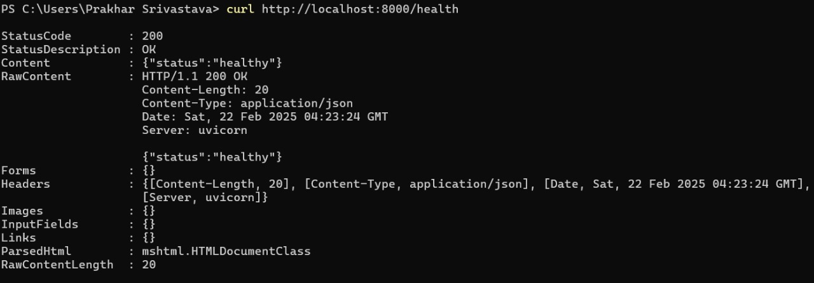
Demo of the Product

Slide 7
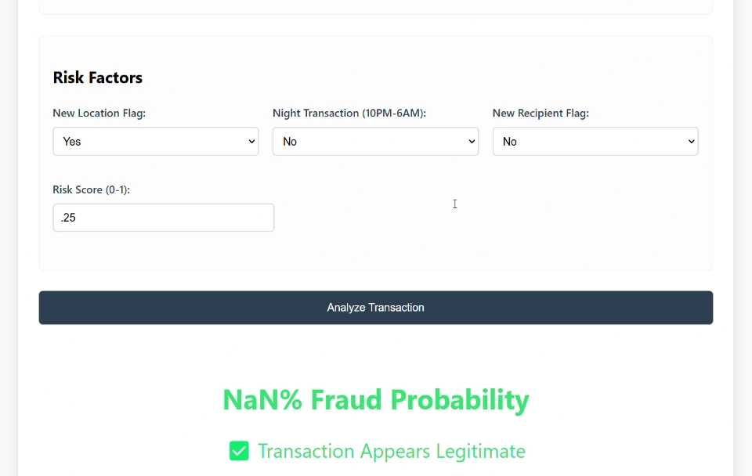
UI

Slide 8
Conclusion
Summary: ML-powered fraud detection.
Impact: Enhanced UPI security.
Future Enhancements:
- Real-time anomaly detection
- Blockchain security
- Advanced deep learning models.

